Slide 1
AWS Services Practical Implementation
Name: P.David Raju
Rollno: 20a31a05i5

Slide 2
Scale and Load balance your Architecture

Slide 3
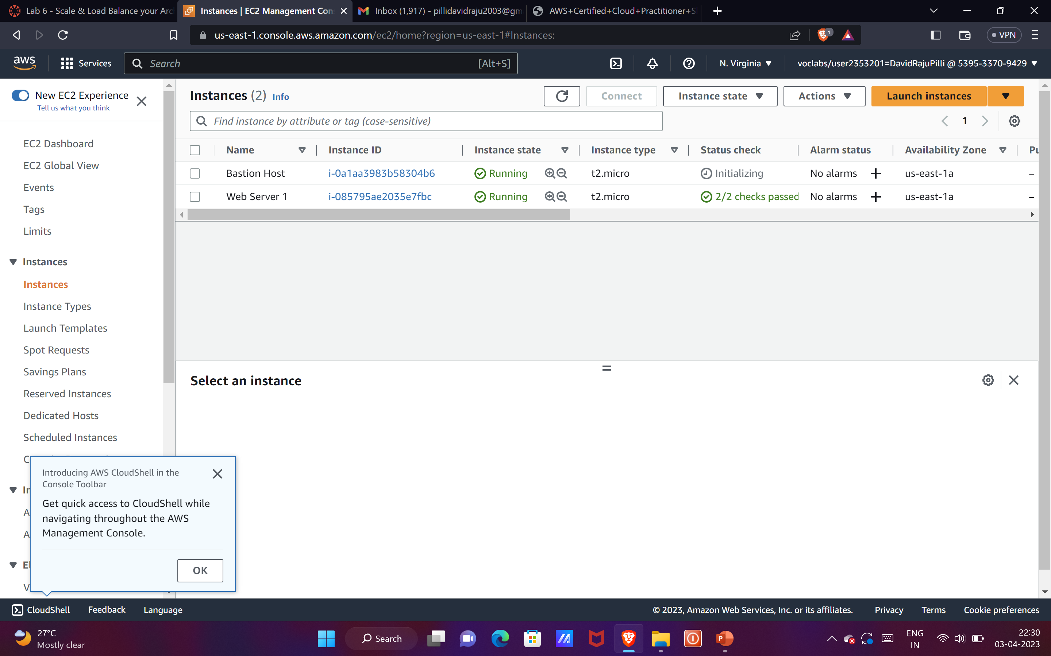
We need to check whether the status checks are done or not.

Slide 4
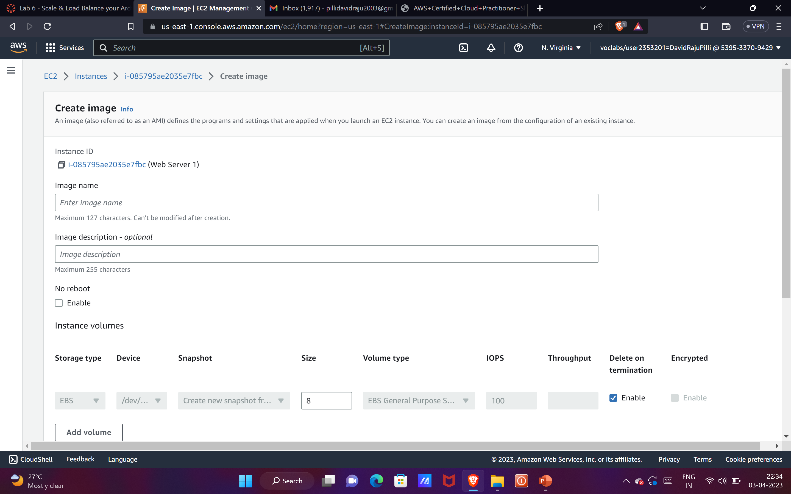
We need to create a image.

Slide 5
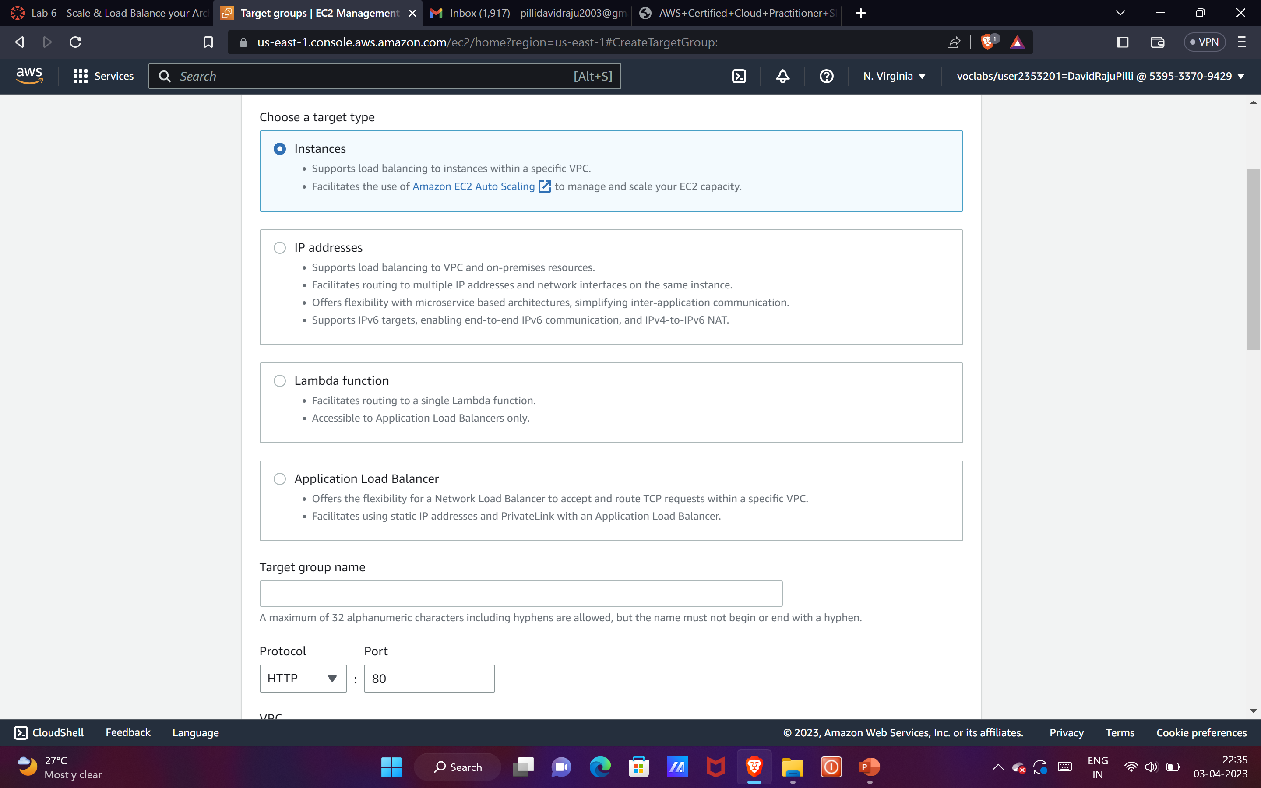
We need to create a target group.

Slide 6
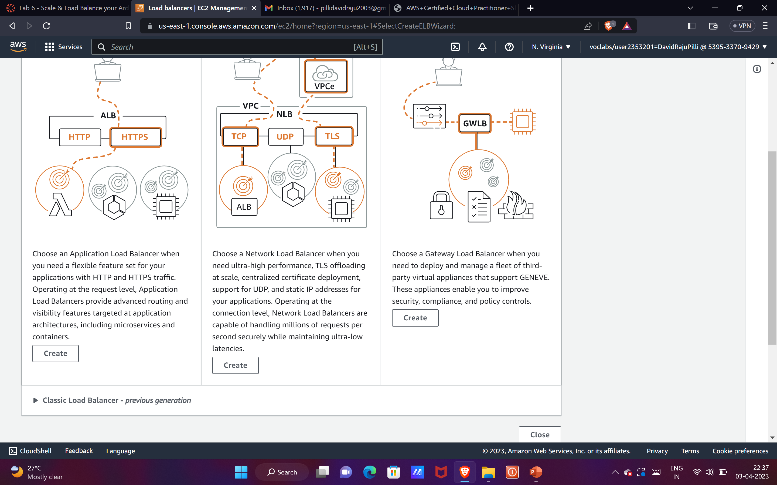
We just need to create a load balancer.
We will need two subnets.

Slide 7
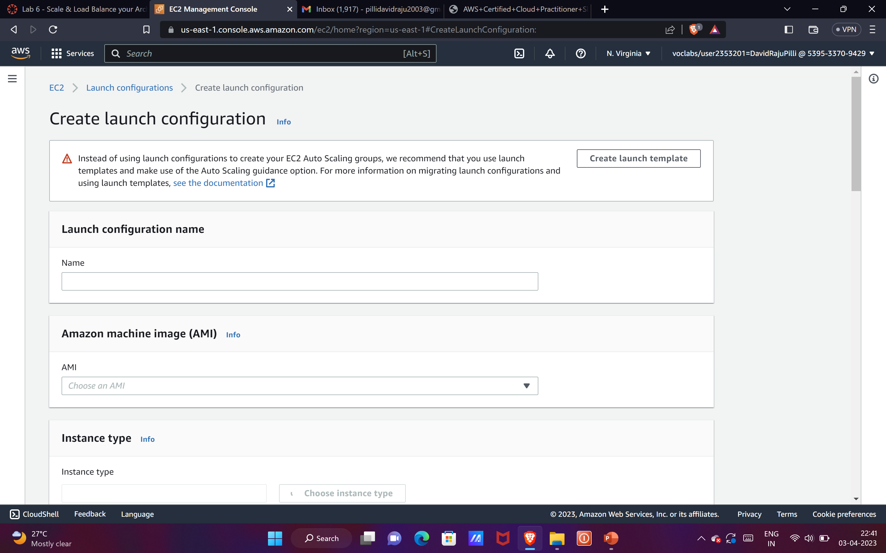
We need to create launch configuration and having t3.micro.
Select enable ec2instance detailed monitoring within cloudwatch.
Under security group we need select Web Security Group.

Slide 8
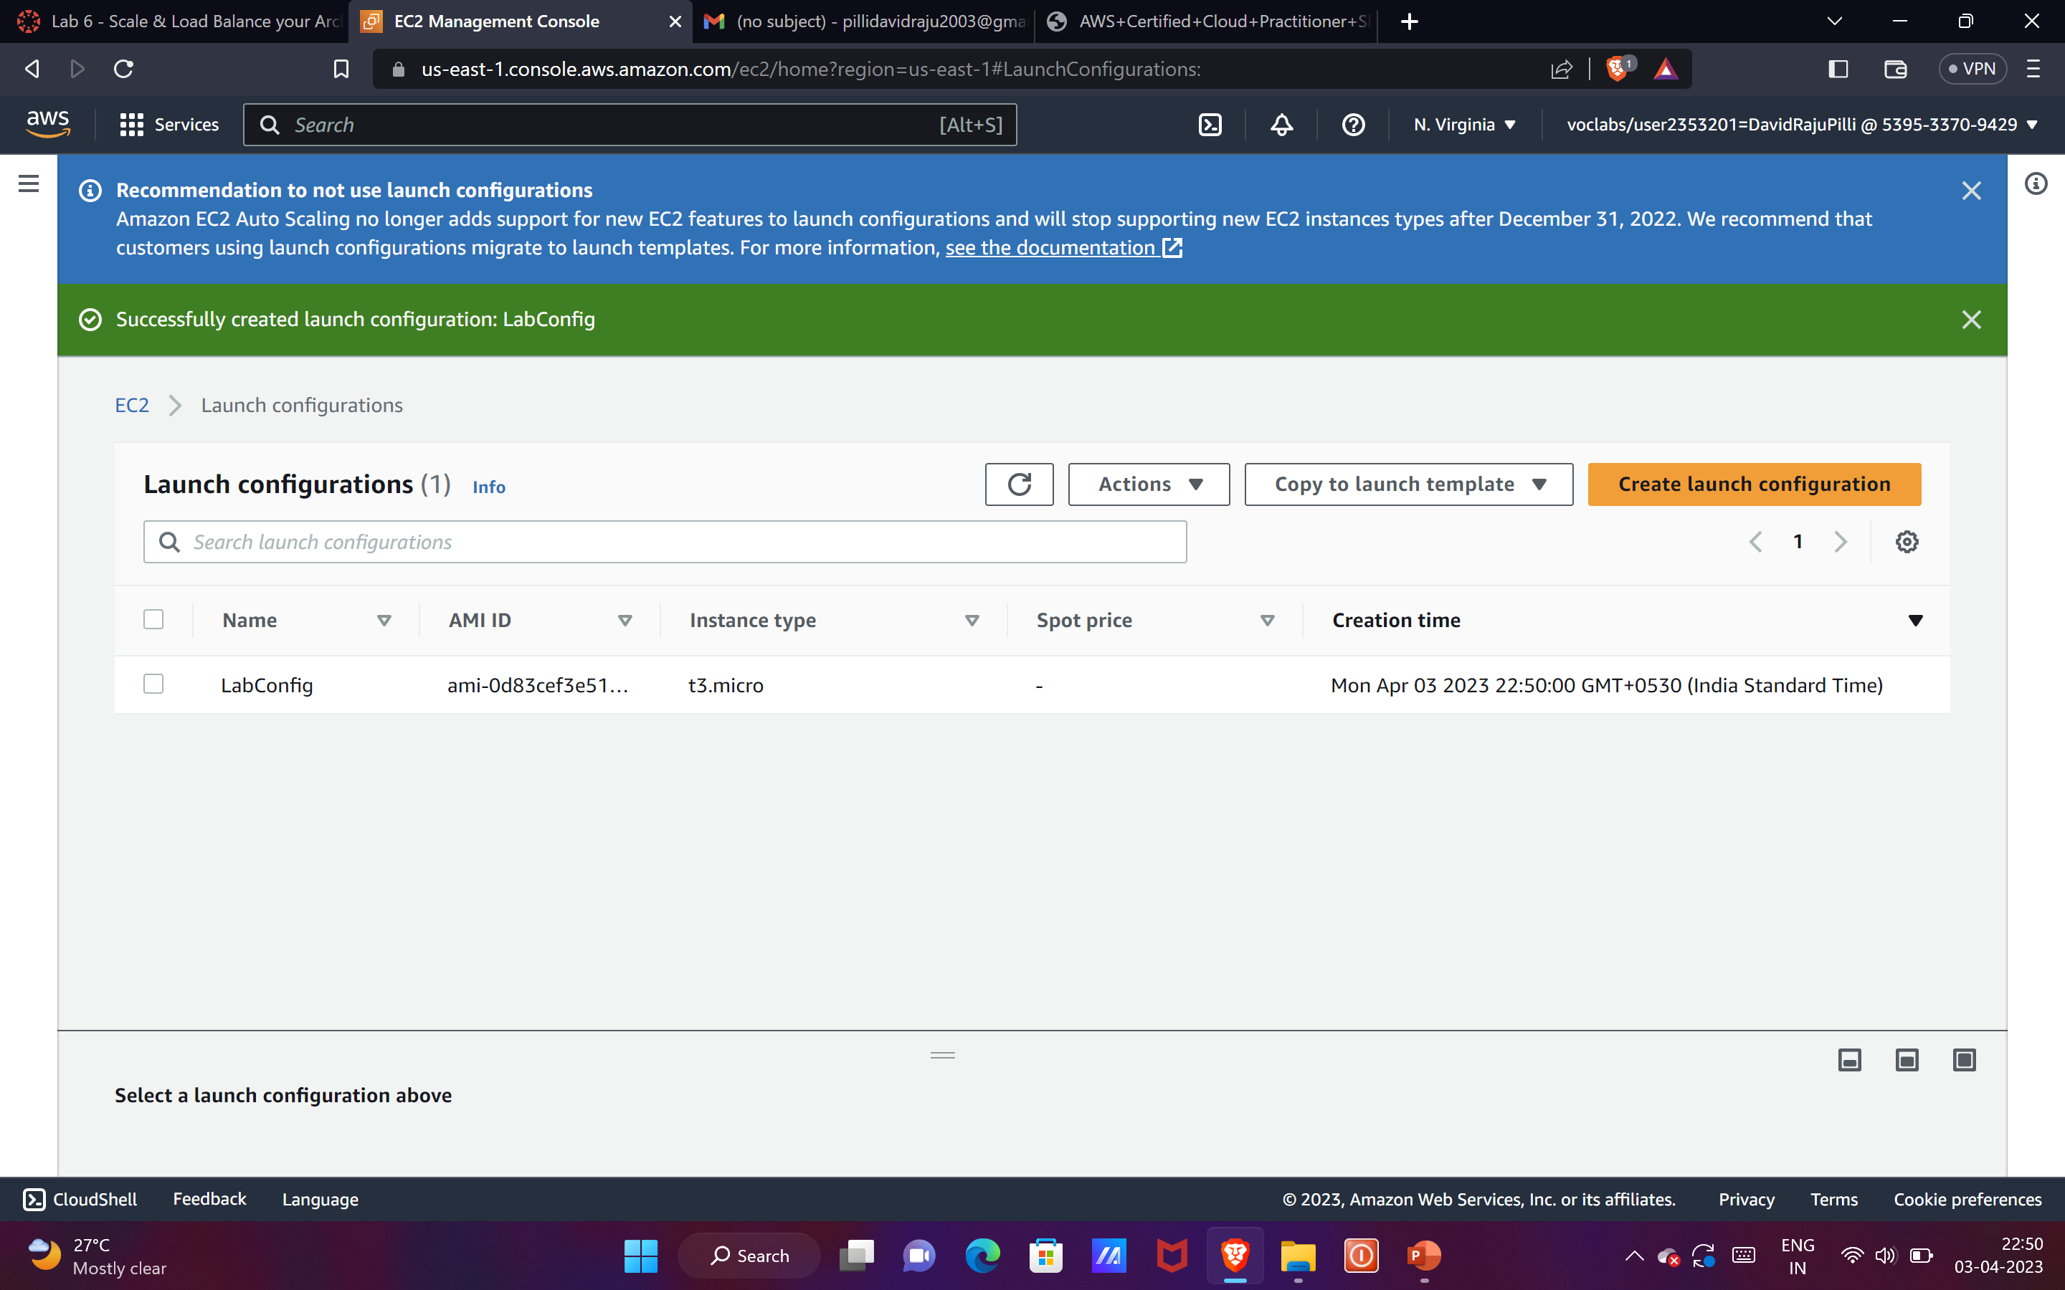
Create auto scaling group, with private subnet 1and2.
We need to attach lab group load balancer.
We need to enable group metrics collection within cloud watch.

Slide 9
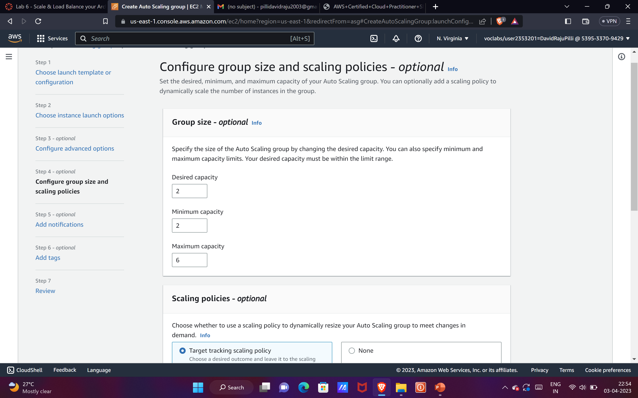
We need to configure group size and scaling policies.
After adding some tags we finally created an auto scaling group.

Slide 10
Verifying whether auto scaling is working or not
Go to instances and you must seetwo lab instances running.
Their health checks must be pass.
Now click target groups>labgroup>targets.
Two lab instances targets must be listed there.
Wait until both of the health checks status is healthy.
Now go to load balancer and copy the DNS of the load balancer and open it in a new tab.
If you get 100% your scaling group is done.

Slide 11
Creating a VPC

Slide 12
Creating a VPC:
After accessing to aws management console, in the search box to the right of services, search and choose VPC to open the VPC console.
In the top right of the screen, verify that N.Virginia (us-east-1) is the region.
Choose the VPC dashboard link which is also towards the top left of the console.
Next, choose Create VPC .Create

Slide 13
Configuring VPC details
Choose VPC and more.
Under name tag auto generation,keep auto-generate selected,however change the value from project to lab.
Keep the IPv4 Block set to 10.0.0.0/16.
For number of availability zones,choose 1.
For number of public subnets,choose 1.
For number of private subnets,choose 1.
Expand the Customize subnets CIDR blocks then change public subnet CIDR block in US East 1a to 10.0.0.0/24
and change public subnet CIDR block in US East 1a to 10.0.1.0/24.
Set NAT Gateway to In 1AZ.
Set VPC endpoints to none.
Keep both DNS host namesand DNS resolution enabled.

Slide 14
Confirming the settings we configured
VPC:lab vpc(say)
Subnets:
Public Subnet Name:lab-subnet-public1-us-east-1a
Private Subnet Name:lab-subnet-private1-us-east-1a
Route Tables:
Lab-rtb-public
Lab-rtb-private1-us-east-1a
Network Connections:
Lab-igw
Lab-nat-public-us-east-1a
Choose Create VPC

Slide 15
Creating additional subnets to a VPC
In the left navigation panel,choose subnets.
Choose Create subnet and then change the following:
VPC ID:lab vpc(because it is the name we given while creating VPC)
Subnet name:lab-subnet-public2
Availability Zone:Choose second in the menu(say)
IPv4 CIDR Block:10.0.2.0/24
Choose Create Subnet
In the same way,we can create second private subnet by changing
IPv4
CIDR Block

Slide 16
Creating a VPC Security Group
In the left navigation panel,choose security groups.
After that,Choose Create Security Group.
Give the name to security group according to our convenience such as Web Security Group.
Add some description to it in order to specify its purpose of creation like “enabling http access”.
For VPC,Choose previous VPCs that you have created.
In the inbound rules panel,Choose Add Rule.
Give the type as HTTP,in order to accept http traffic.
Give the source as Anywhere from IPv4.
Add the description to your inbound rule in order to specify its purpose of creation like “Permit Web Requests”.
Finally we can create a security group by choosing “Create security Group”.

Slide 17
Launch a Web server Instance

Slide 18
In the search box to the right of Services, search for and choose
EC2 to open the EC2 console.
From the Launch instance menu choose Launch instance.
Name the instance
Give it the name Web Server 1
Choose an AMI from which to create the instance
In the list of available Quick Start AMIs, keep the default Amazon
Linux selected.
Also keep the default Amazon Linux 2023 AMI selected.

Slide 19
Choose an Instance type
In the Instance type panel, keep the default t2.micro selected.
Select the key pair to associate with the instance:
From the Key pair name menu, select vockey.
Configure the Network settings:
Next to Network settings,
choose Edit, then configure:
Network: lab-vpc
Subnet: lab-subnet-public2 (not Private!)
Auto-assign public IP: Enable

Slide 20
Next, you will configure the instance to use the Web Security Group that you created earlier.
Under Firewall (security groups), chooses Select existing security group.
For Common security groups, select Web Security Group.
This security group will permit HTTP access to the instance.
In the Configure storage section, keep the default settings.
Configure a script to run on the instance when it launches
Expand the Advanced details panel.
Scroll to the bottom of the page and then copy and paste the code shown below into the User data box.

Slide 21
#!/bin/bash
# Install Apache Web Server and PHPsudo dnf install -y httpd we get php mariadb105-server
# Download Lab files we get https://aws-tc-largeobjects.s3.us-west-2.amazonaws.com/CU R-TF-100-ACCLFO-2-9026/2-lab2-vpc/s3/lab-app.zipunzip lab-app.zip -d /var/www/html/
# Turn on web server
chkconfig httpd on
service httpd start
At the bottom of the Summary panel on the right side of the screen choose Launch instance Choose View all instances

Slide 22
Wait until Web Server 1 shows 2/2 checks passed in the Status check column.
Select Web Server 1.
Copy the Public IPv4 DNS value shown in the Details tab at the bottom of the page.
Open a new web browser tab, paste the Public DNS value and press Enter.

